Slide 1
Outline for today
–L only and +S only “mosaics”
Changes to MI and firing rate penalty
Quest to finding +L or –S only mosaics

Slide 2
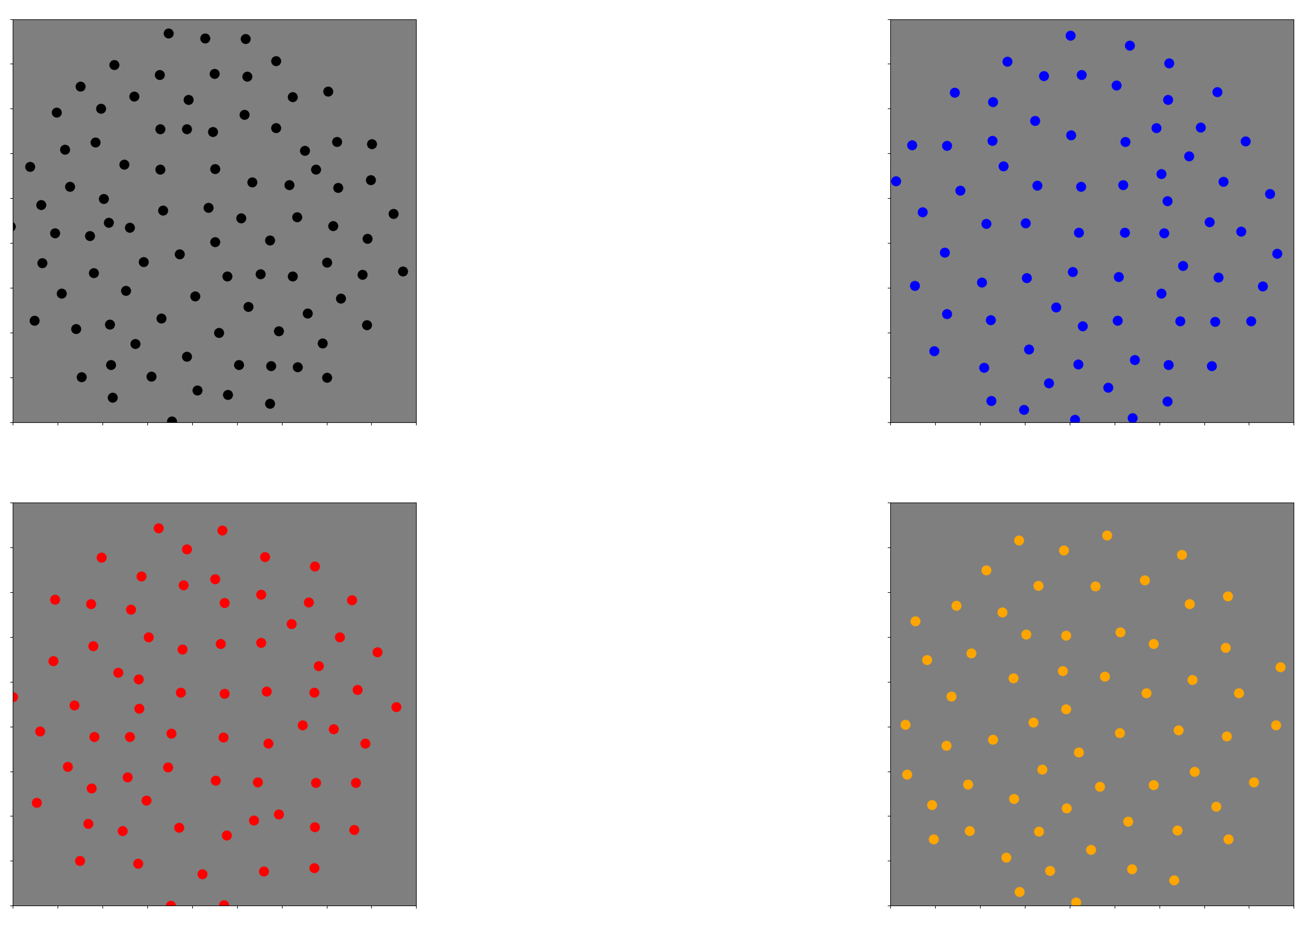
Recap from last week: mosaics

Slide 3
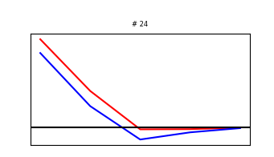
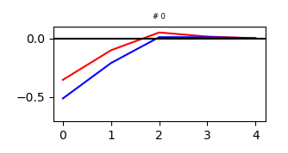
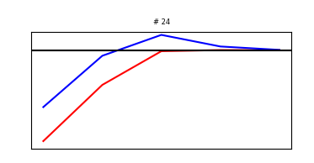
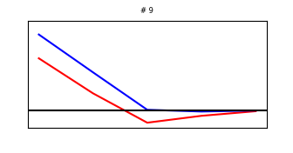
Recap from last week: RF types

Slide 4
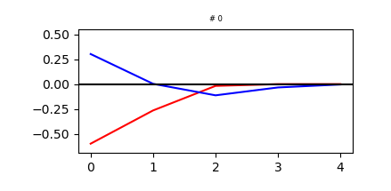
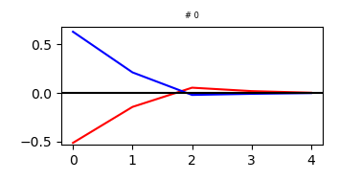
Changing d parameter: Manipulations

Slide 5
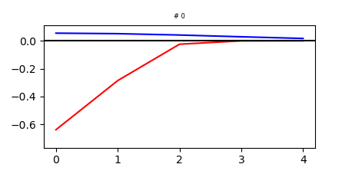
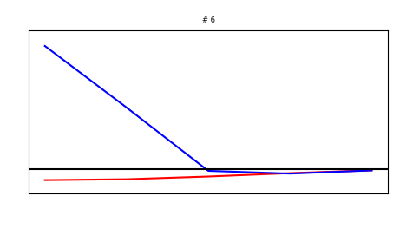
New RF types
Manipulation
Training

Slide 6
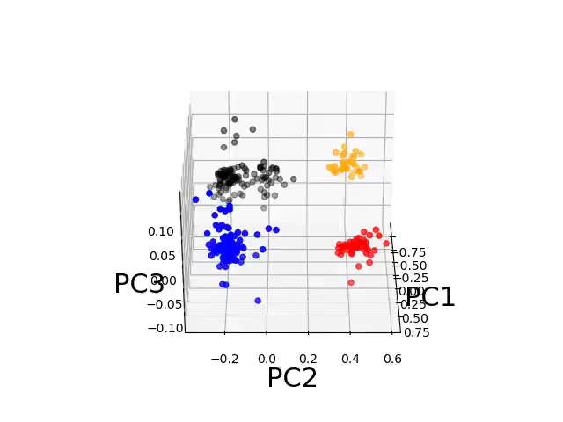

Slide 7
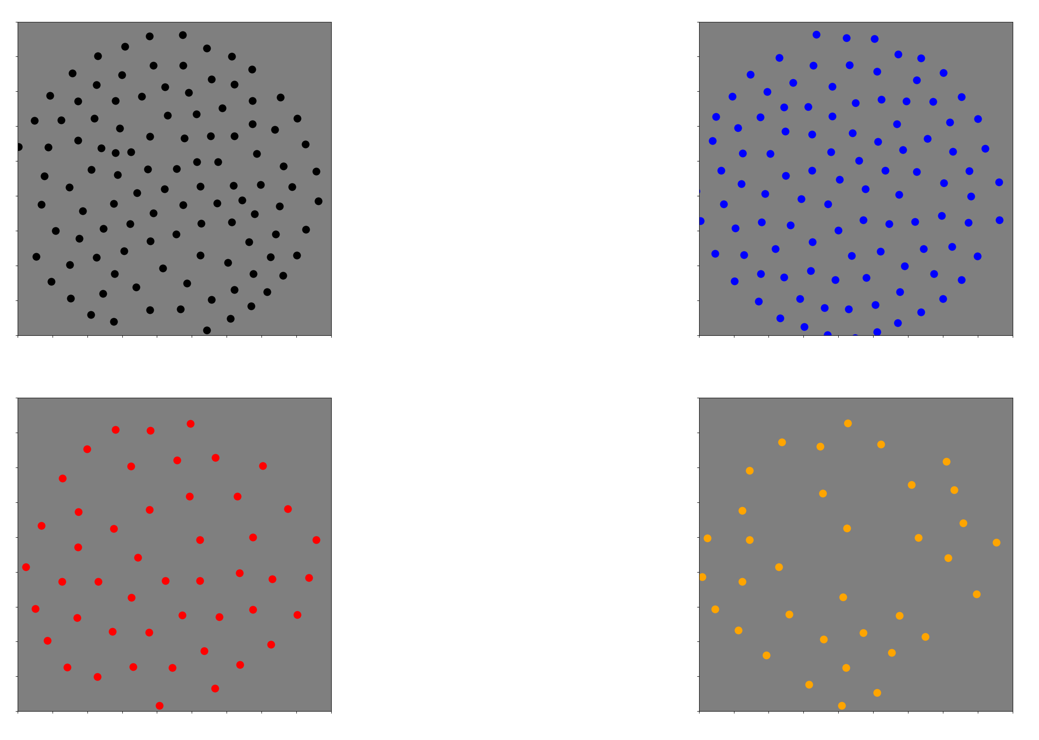
New mosaics

Slide 8
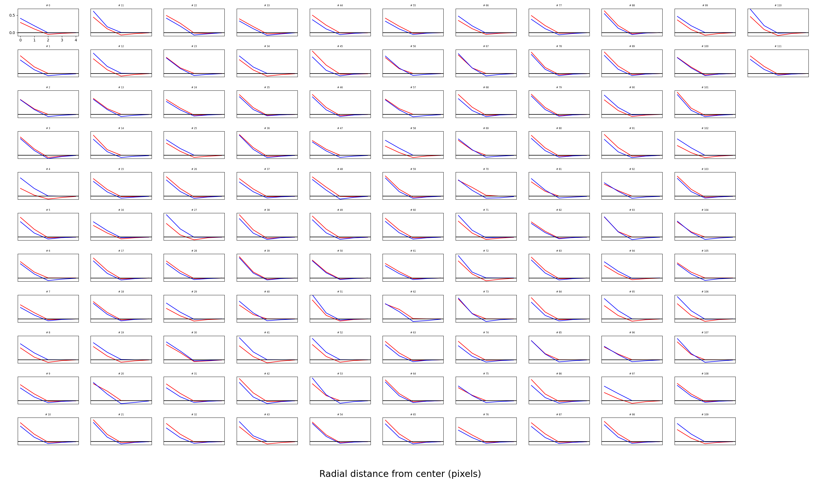

Slide 9
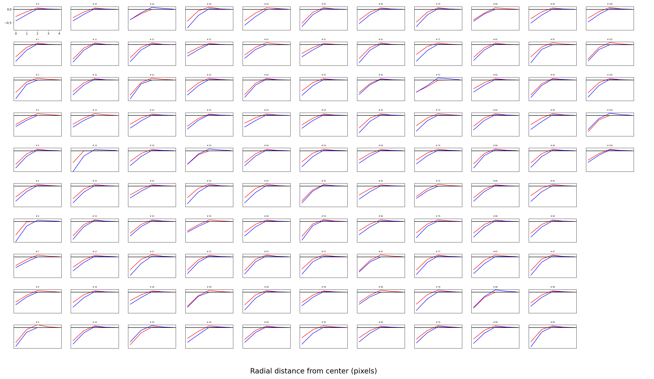

Slide 10
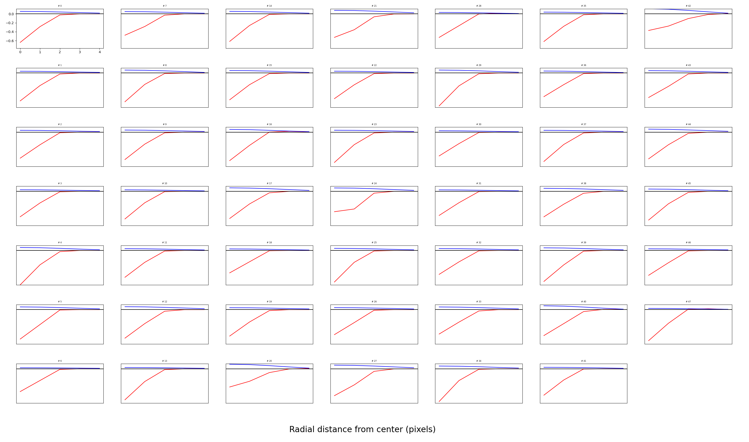

Slide 11
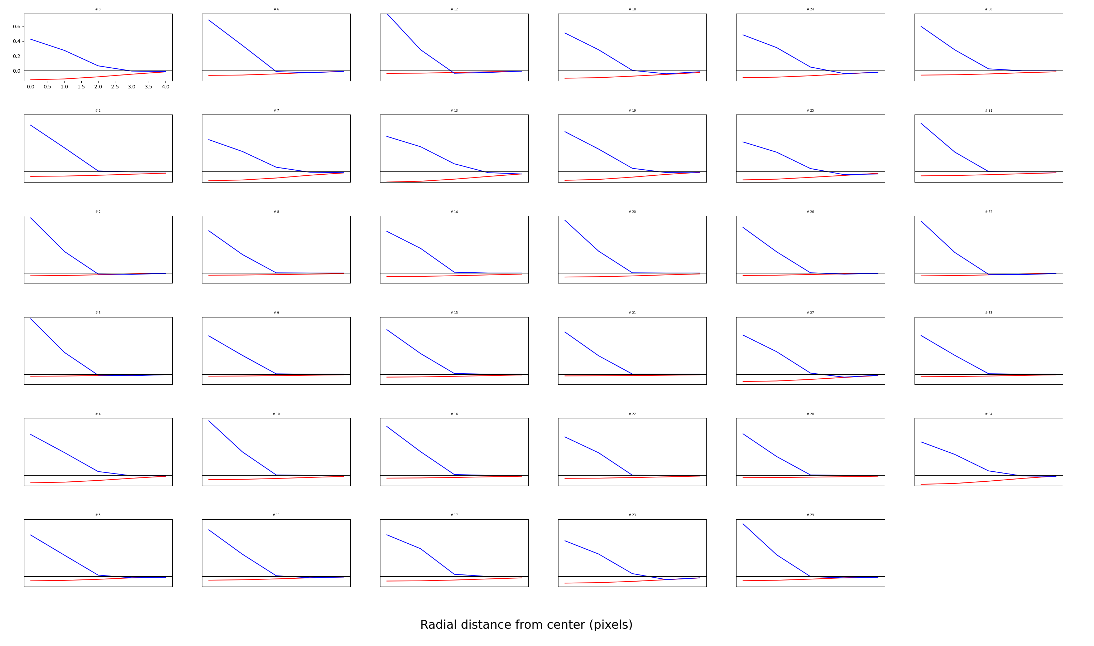

Slide 12
Neurons “hop” mosaics to the first two
Prior to changes, number of neurons in each mosaic was similar
After changes, roughly all neurons in the first two mosaics remained in the same mosaic
33% of neurons in the L OFF mosaic went to the regular OFF Mosaic.
50% of neurons in the S ON cluster went to the regular ON cluster.

Slide 13
Hopping still happens despite the following changes:
Flip d one mosaic at a time, and train before next.
Reduce learning rate 10x

Slide 14
Estimating loss over training steps
You can’t “stitch” two Tensorboard files together
Estimates are noisy: It would be much better to estimate loss over multiple (e.g. 50) batches instead of just 1.

Slide 15
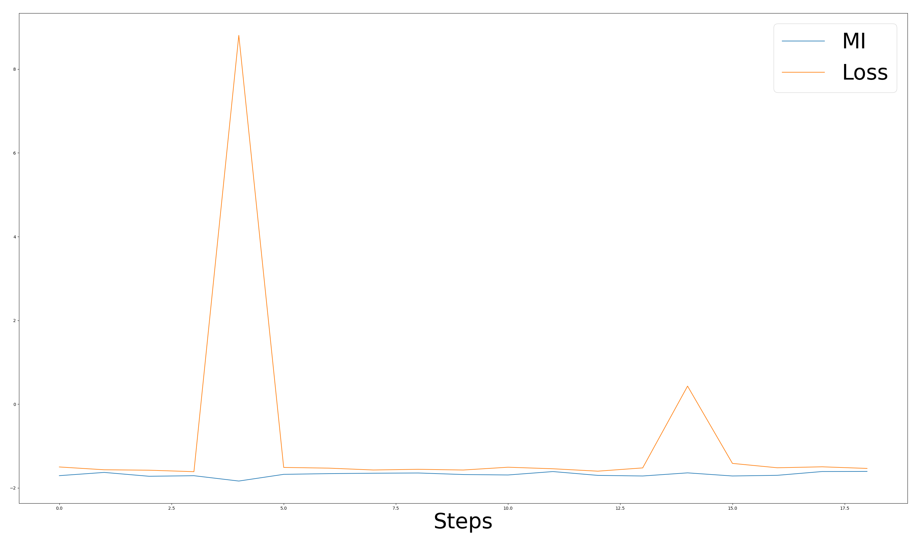
Reversing the weaker channel increases firing rate but does change MI
I do not know why the firing rate goes up

Slide 16
What if I directly set the other channel to 0?
It almost instantly goes back to the previous RFs

Slide 17
Quest to finding +L or –S clusters

Slide 18
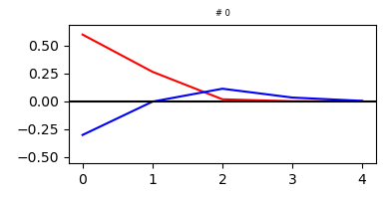
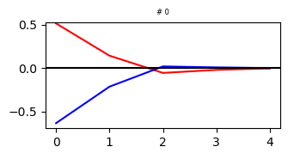
What if we reverse the stronger channel?
Manipulation
Training

Slide 19
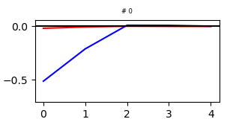
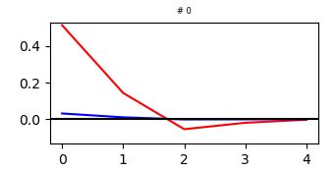
What if we set the other channel to 0?
Manipulation
Training

Slide 20
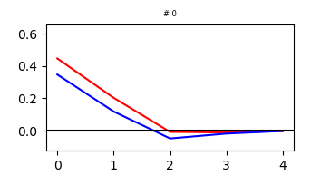
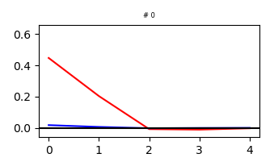
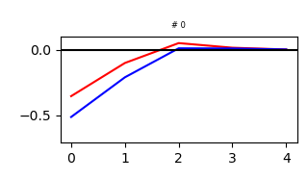
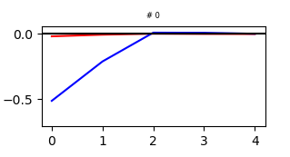
What if we set to zero the weaker channel in the other mosaics?
Manipulation
Training

Slide 21
What if we reverse the weaker channel in the other mosaics?

Slide 22
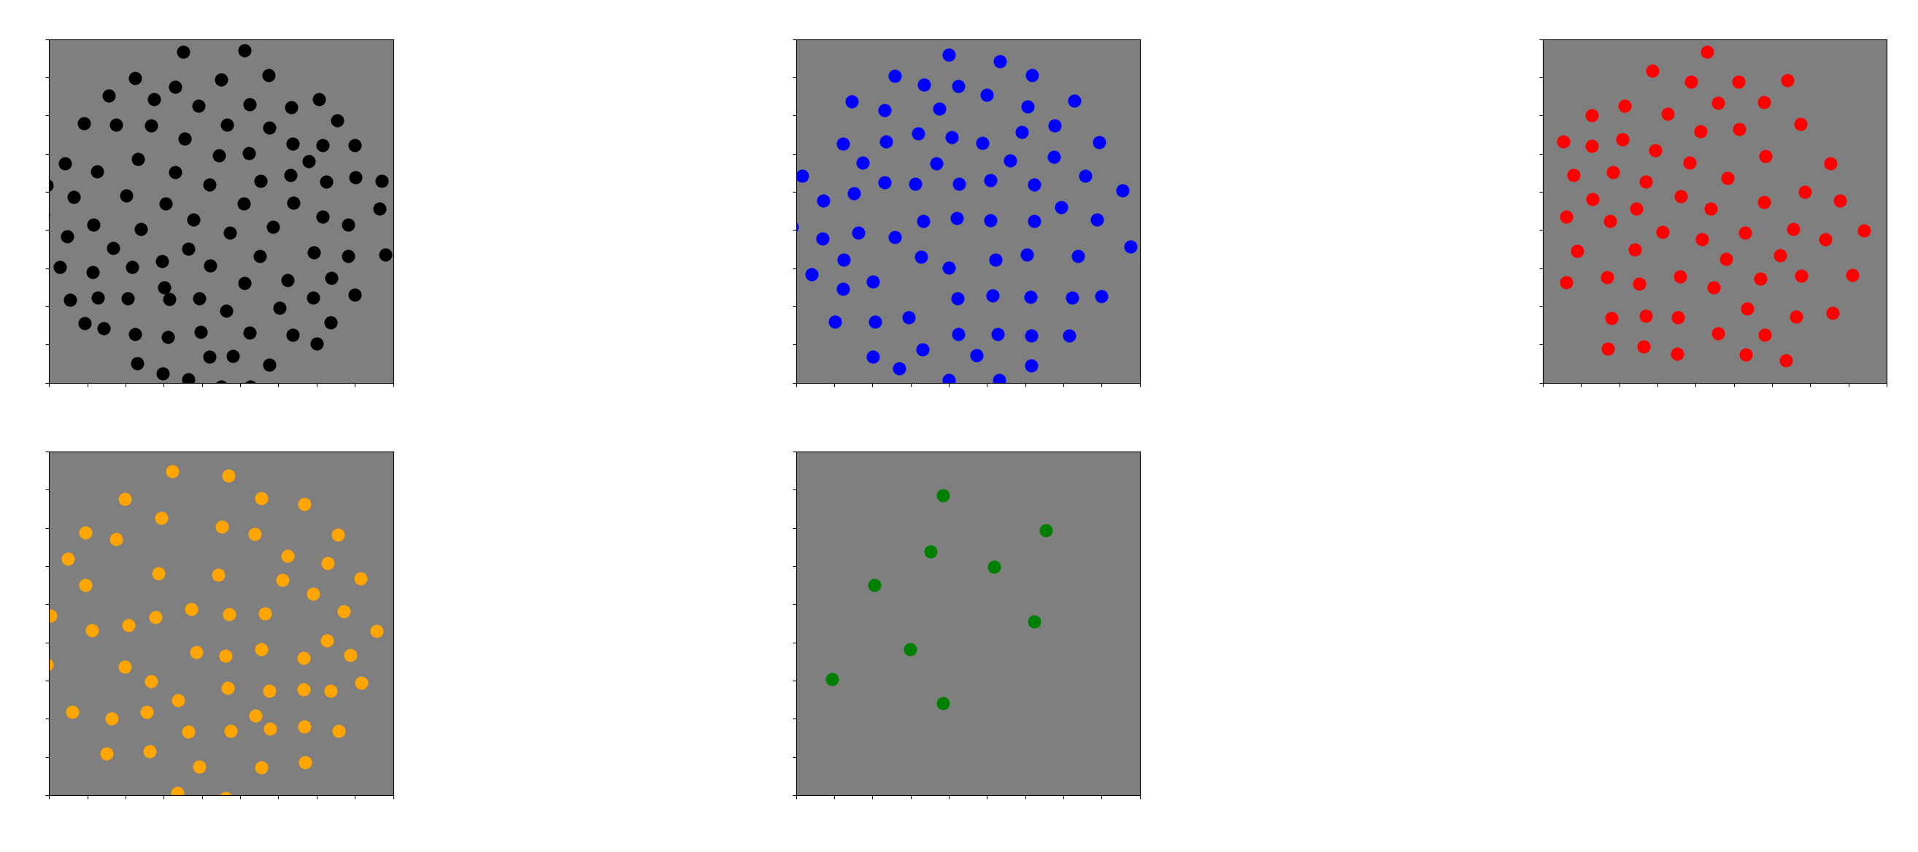

Slide 23
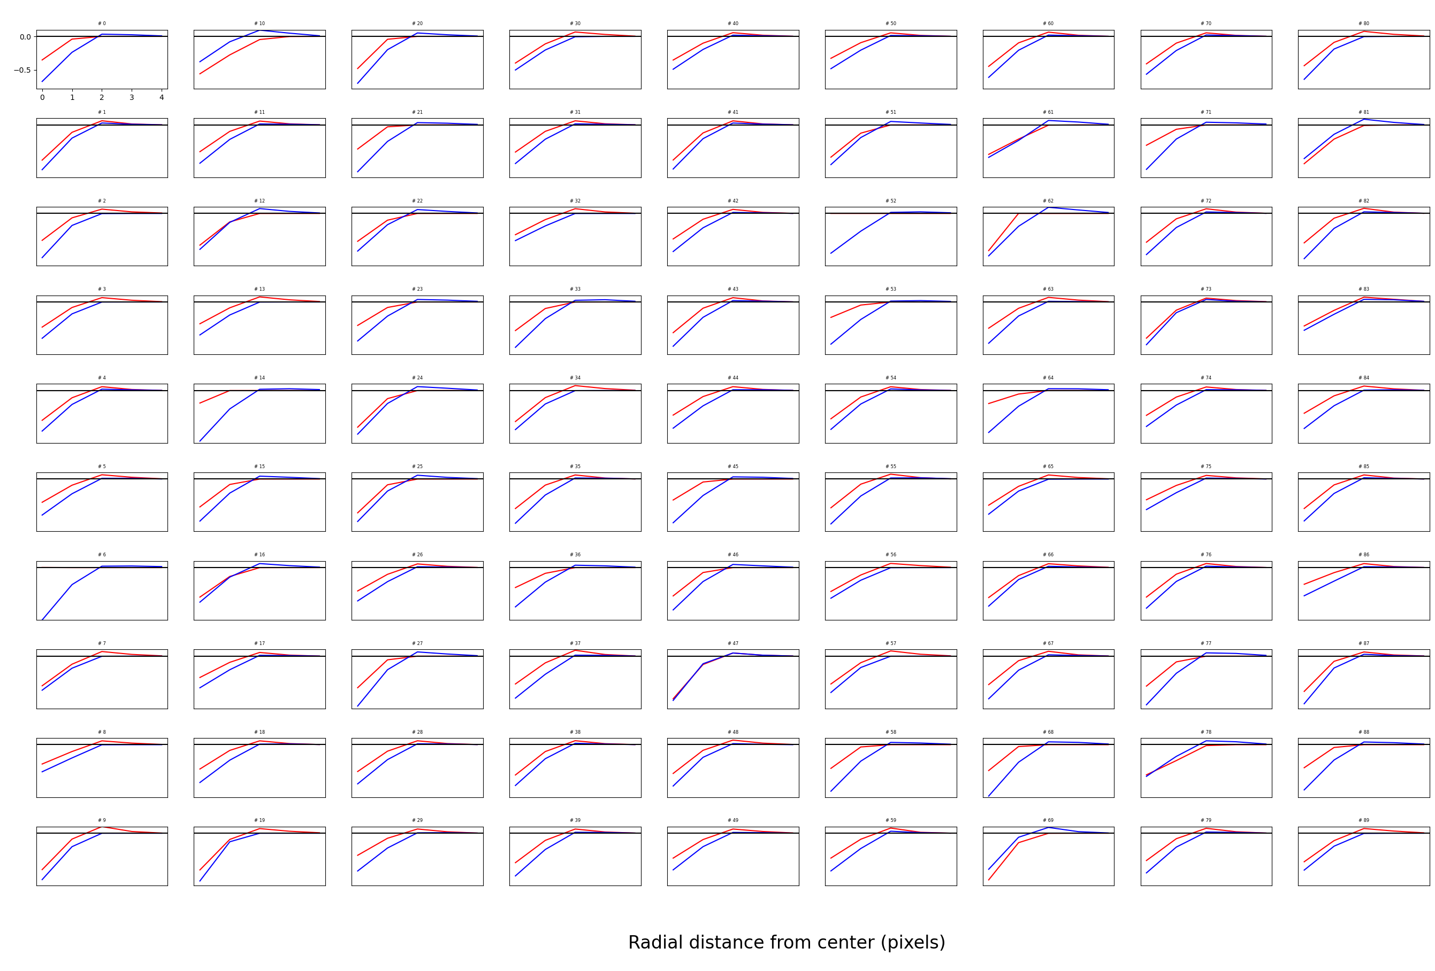

Slide 24
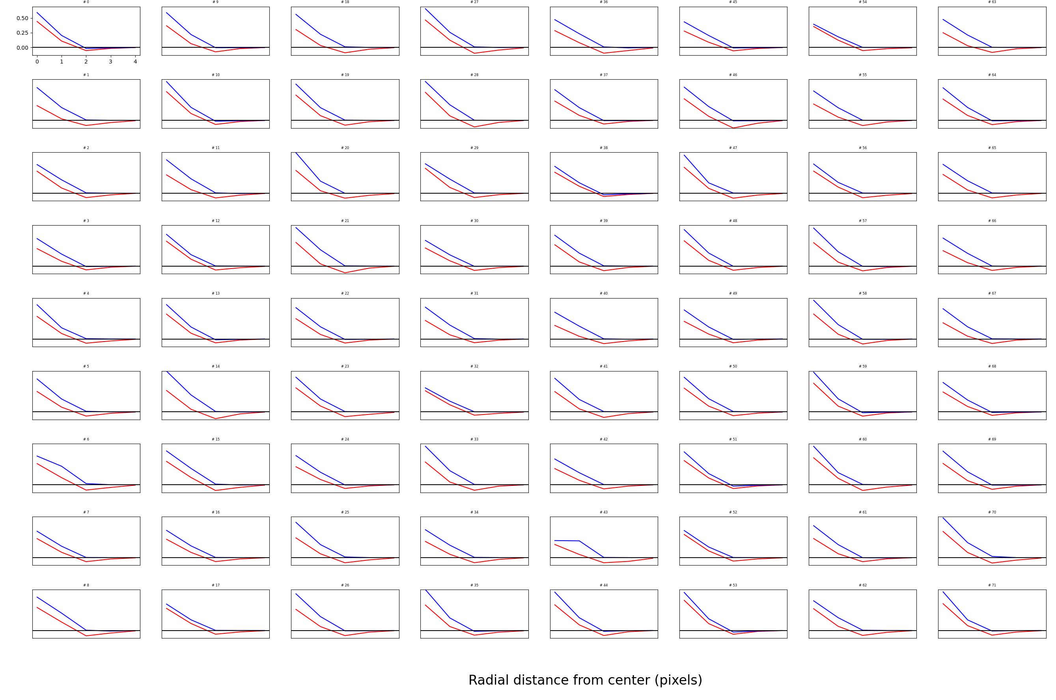

Slide 25
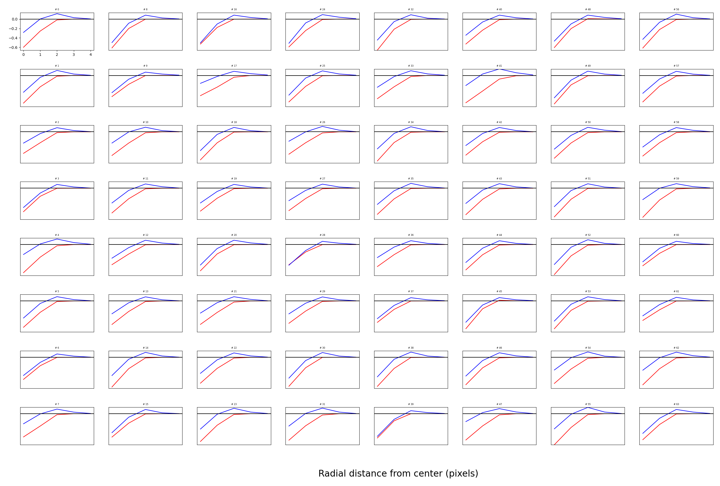

Slide 26
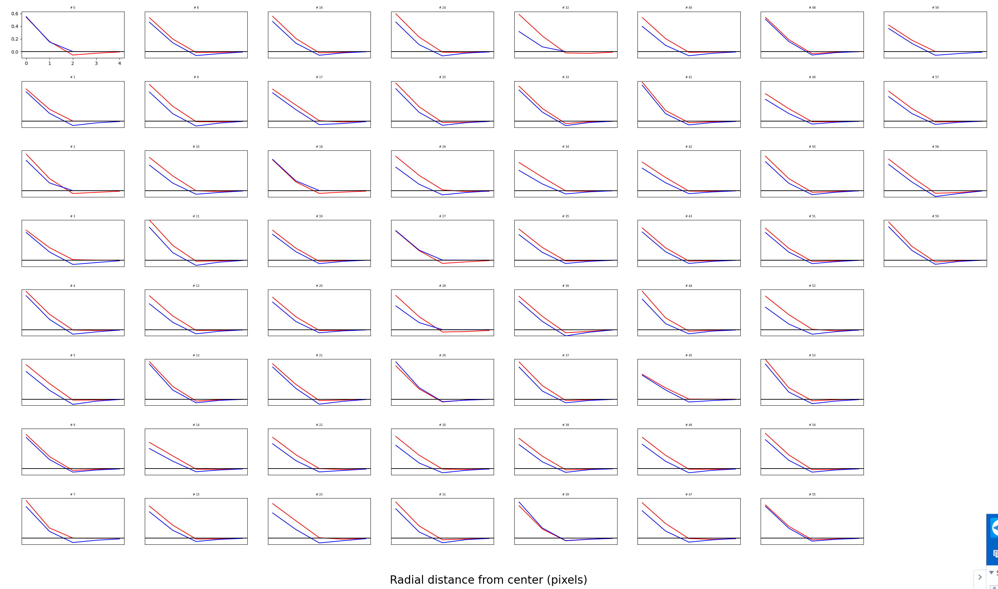

Slide 27
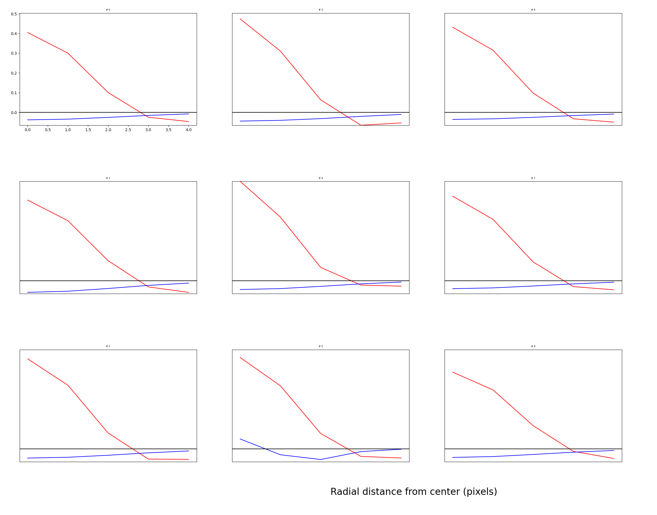

Slide 28
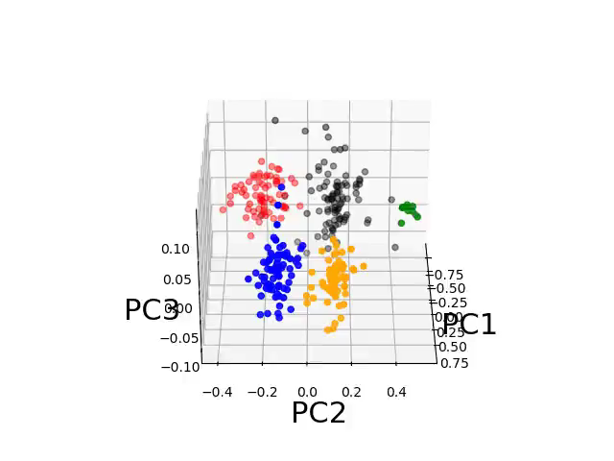

Slide 29
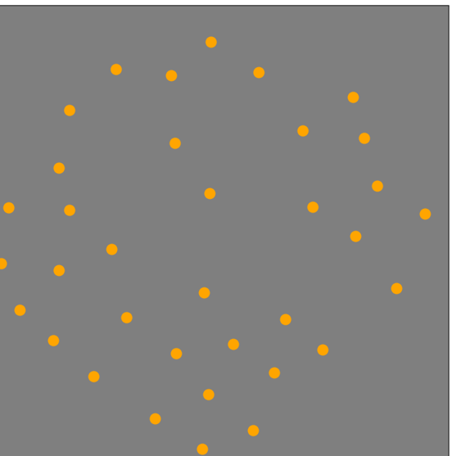
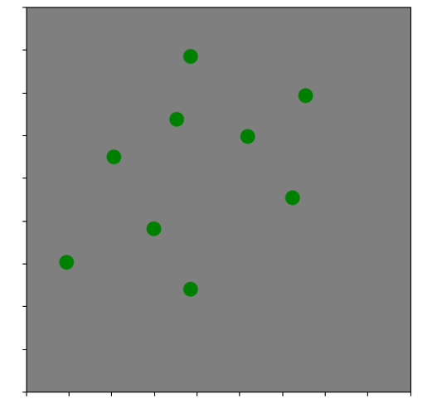

Slide 30
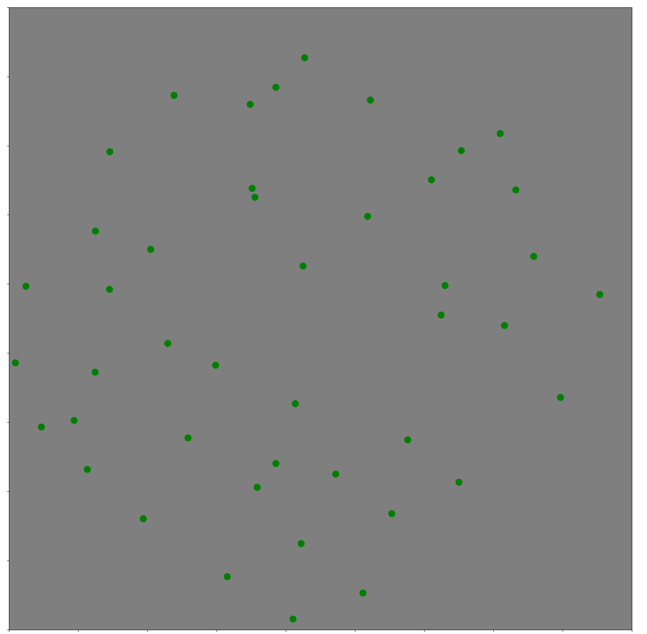
If I “patch” the incomplete +S mosaic, and the incomplete +L mosaic (from different runs), they kind of complement each other

